Slide 1

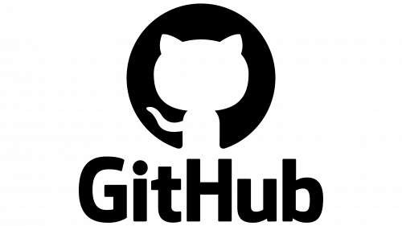
Version control and collaborative workflow
Yohanis Alemeshet
HHR Data Science Interest Group,
Harar, August 2025

Slide 2
Outline
What is version control, and why?
Git Vs GitHub
Creating a repository
Collaborating using GitHub
Cloning Vs forking
Branching
Pull requests

Slide 3

What is version control?
A system that tracks and manages changes to files, typically code, programs, and directories over time.

Slide 4

Why version control?
Dynamic (Tracking changes)
Collaboration
Documentation
Knowledge Retention

Slide 5
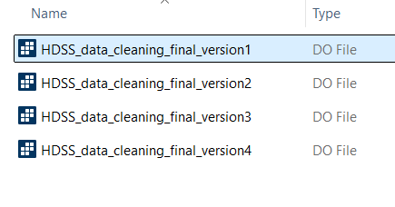
Traditional version control

Slide 6
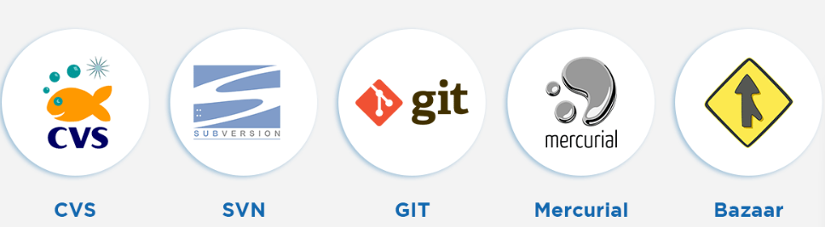
How do we perform version control?
Tools for version control

Slide 7



How do we perform version control?
Open source
Scalable
It stores everything - nothing is ever lost.
Allows us to compare the contents of files at different times.
If our code has issues, we can revert to a previous version.
Git

Slide 8
Git . . .
Command line - Git bash/terminal
GUI – GitHub desktop
Git

Slide 9
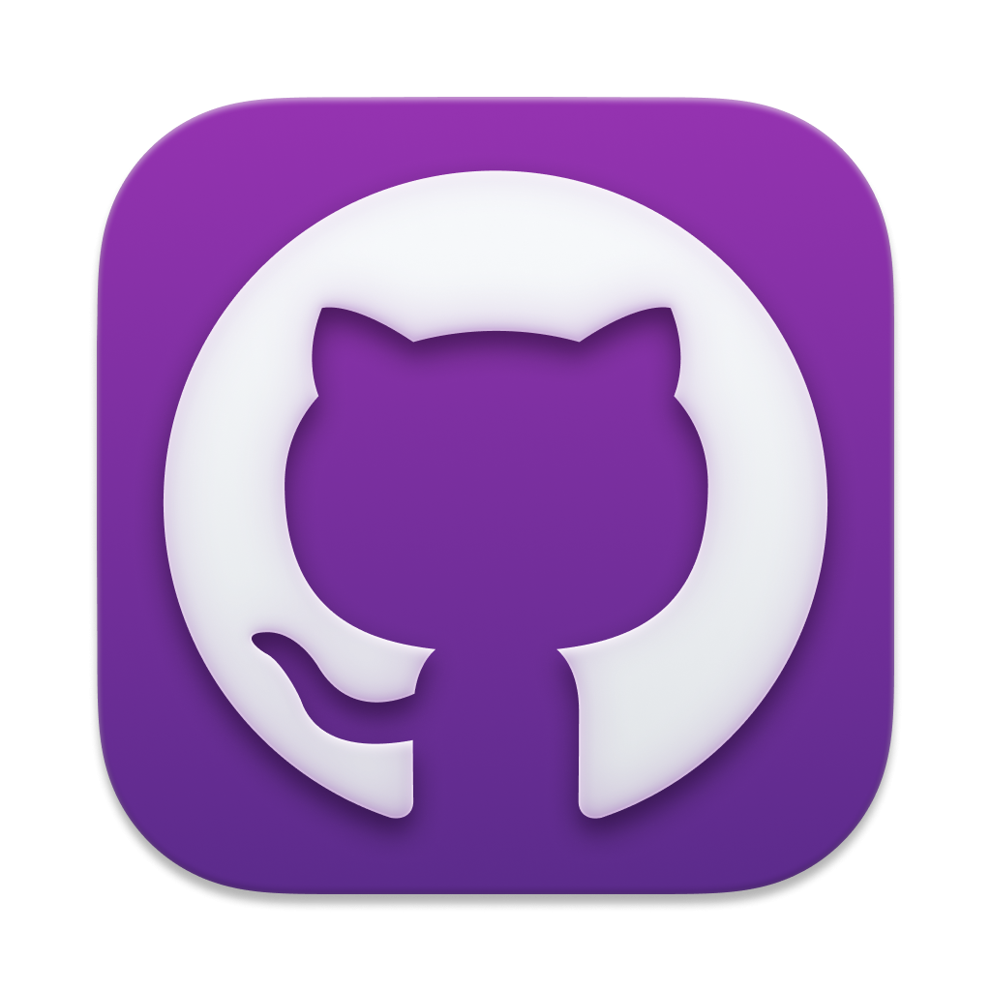

Git, GitHub desktop, GitHub
Git
The actual version control software.
Git is a version control software and can be used independently
GitHub desktop
Allows us to run git in a graphical user interface.
GitHub
A web that hosts our repositories.
Provide platform for collaboration.
Discover other repositories.

Slide 10
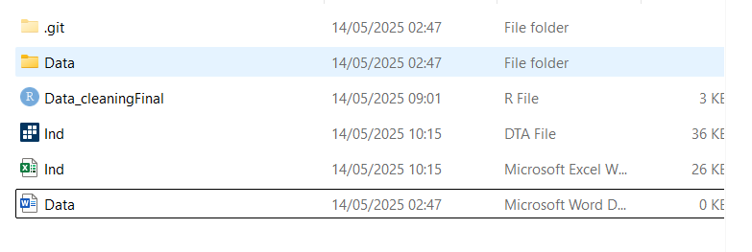
Creating Repository
Git Repository (Repo): is a directory containing files and sub-directories, and Git storage (.git).
1
2
Files
Sub-directory
Git storage
Ind.dta
Data
.git
Ind.xlsx
Extra information Git records about the preject
Data_cleaning.r
Data.doc

Slide 11
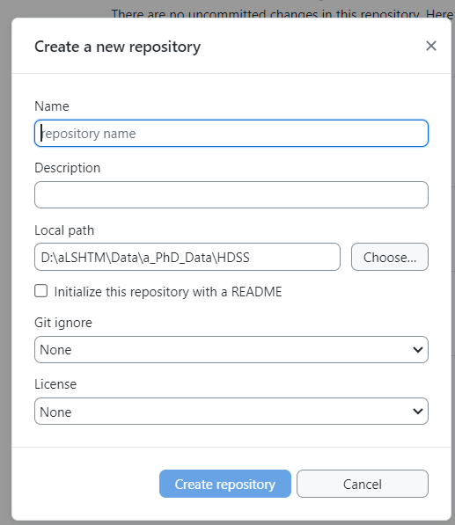
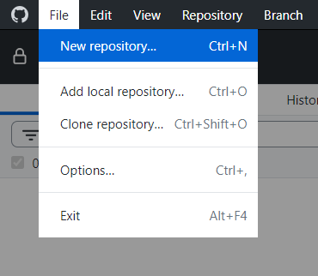
Creating a new repo

Slide 12
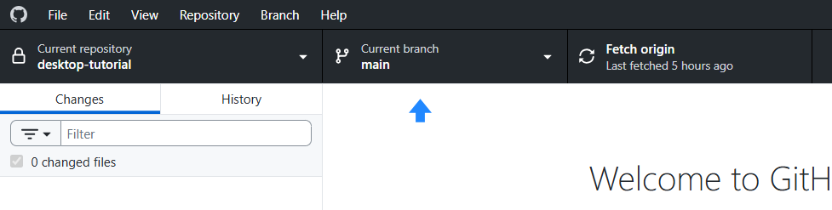

Slide 13
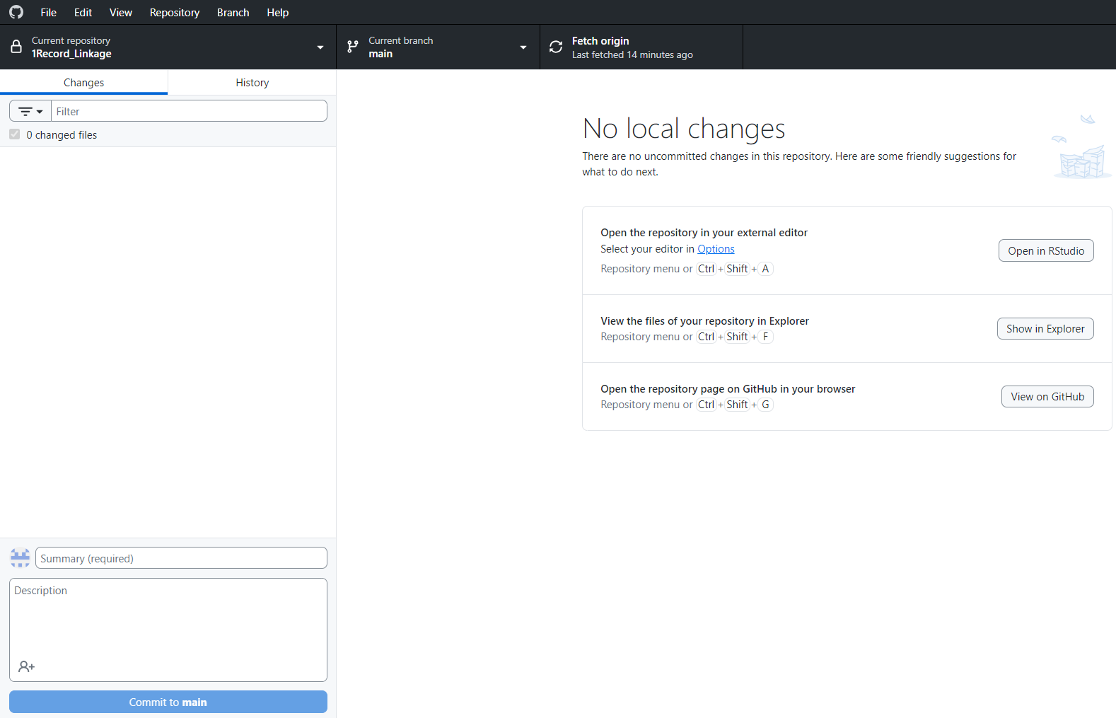
GitHub desktop
Commit – a snapshot of our repo at a specific time

Slide 14
Best Practice
Never commit sensitive information.
Use .gitignore for data files.
README files for each project.
Write good commit messages
Commit logical units of work

Slide 15
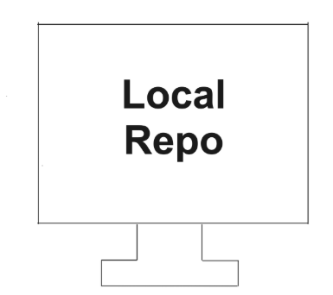
Working with GitHub
Remote Repo
GitHub
Since GitHub stores a project in the cloud, anyone can access it.
Easy to collaborate.
Limited storage – .gitignore should be used

Slide 16
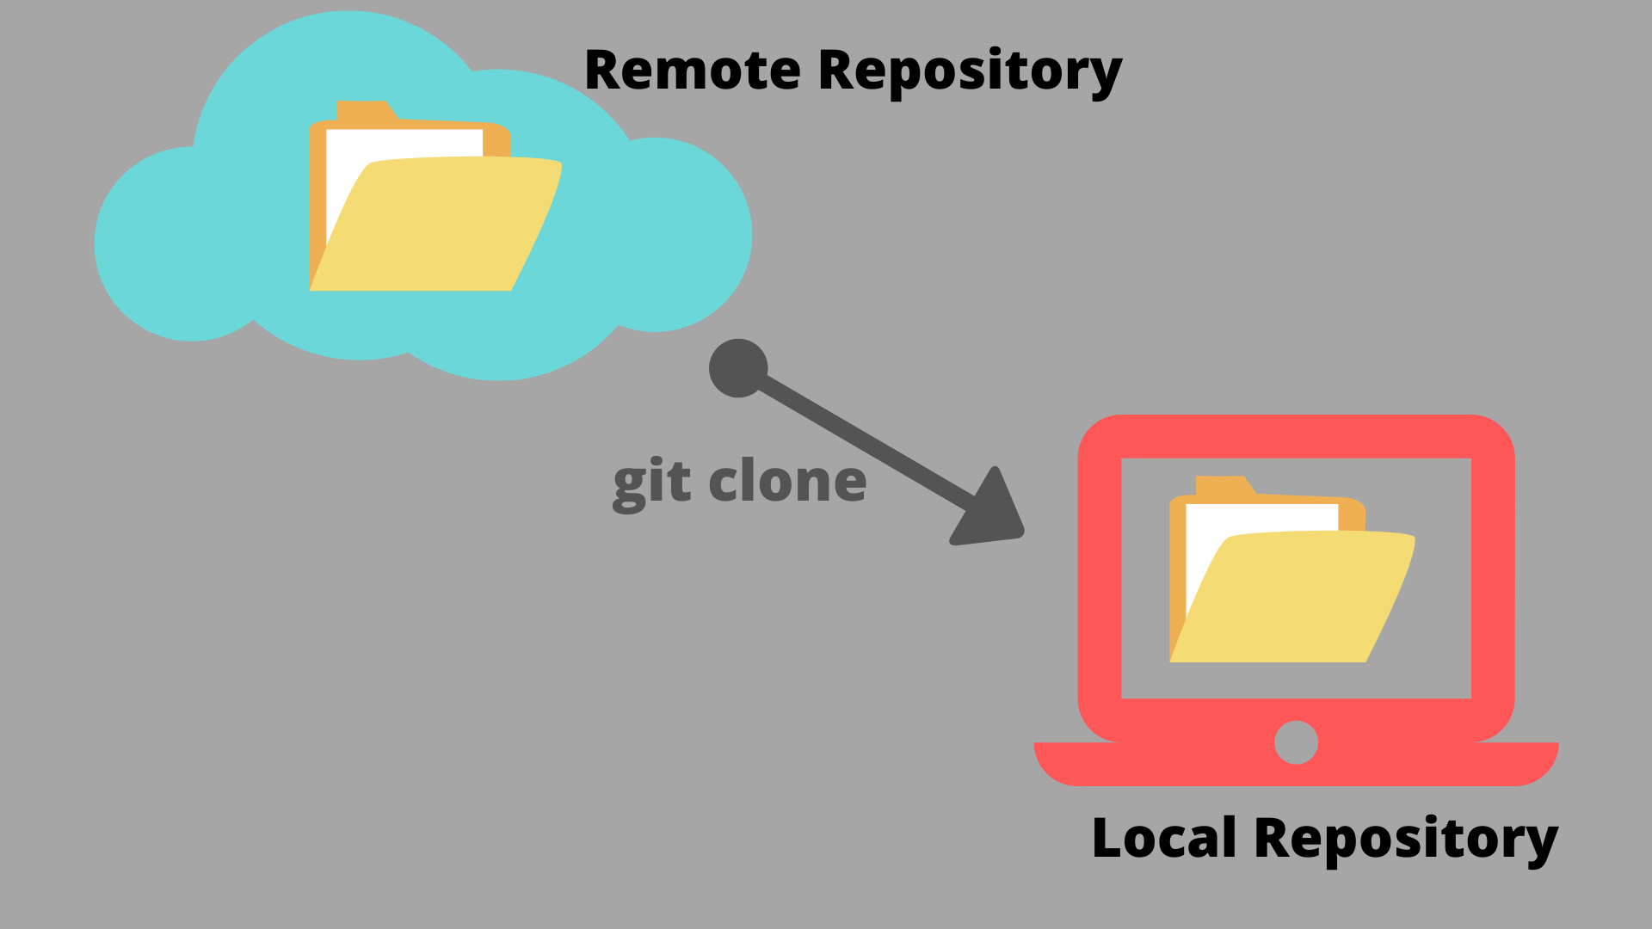
Cloning
Copy-paste
Linked to the original repo
Creates a copy on a local computer
Allows updates to go back and forth
It works with Git
Push changes back to the original repo

Slide 17

Forking
Forking creates an independent copy
Good to run experiments without risk
Used for collaboration
Anyone can fork a public repo
Different to creating a new branch where we need to be collaborators.

Slide 18
Clone vs Fork
Cloning
Creates a linked copy on a local computer
Requires use of Git
Push and pull updates with Git
Forking
Creates an independent copy on GitHub
Can all be done within GitHub
Submit changes through a pull request
Great for collaboration and experimenting

Slide 19
Pull request
A way to notify others about changes
Allows the repo owner to check changes before they are added
Best practice to add changes to a branch that is not the main branch
A successful PR is merging two branches

Slide 20
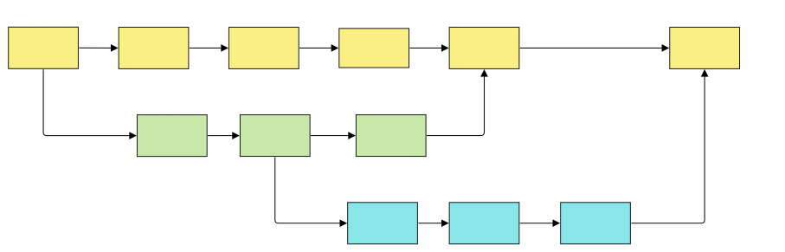
Branches
Allows concurrent work on d/f parts of a project
Help reduce the risk of conflicting file versions
Main
Preg. Outcome
Preg. obs

Slide 21

Branches
Branch protection rule
Ask a pull request
Pull requests should be approved before merging

Slide 22

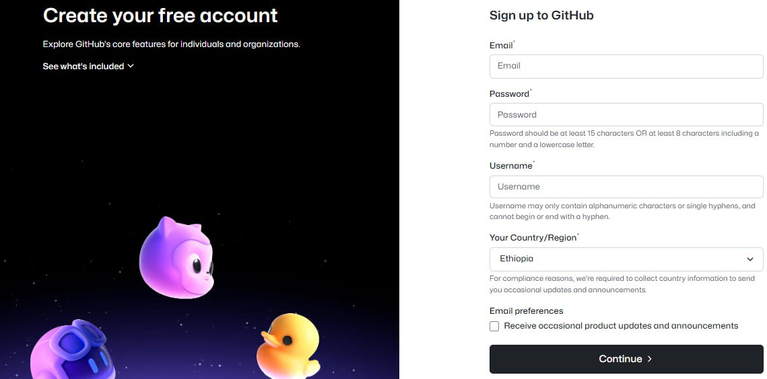
Prerequisite for practicum
Programs
Git
GitHub desktop
GitHub Account

Slide 23
Practicum 1: Creating repository
Create a Local and remote Repo using Git, GitHub desktop and GitHub
After logging in to the GitHub desktop create a local repository called “Data_Manipulation” in your local machine and push it to the GitHub (remote repo).
Initialise with README file.
Start tracking the version of your code.
Add .gitignore

Slide 24
Practicum 2: Collaboration – clone and collaborate
Adding another person as a collaborator.
Clone the repo to your local machine
Collaborate on the repo by writing more data manipulation code
Use arrange and mutate verb in addition to filter
Appreciate changes made by the collaborator.
Discuss the advantage and disadvantage.

Slide 25
Practicum 3: Forking the repo and collaborate
Create a new repo called (Data-manipulation-Visualization).
Add a collaborator
The collaborator has to fork the repo first.
Add codes for visualisation using ggplot2 package (the collaborator).
Create pull request.

Slide 26
Thanks!

